Slide 1
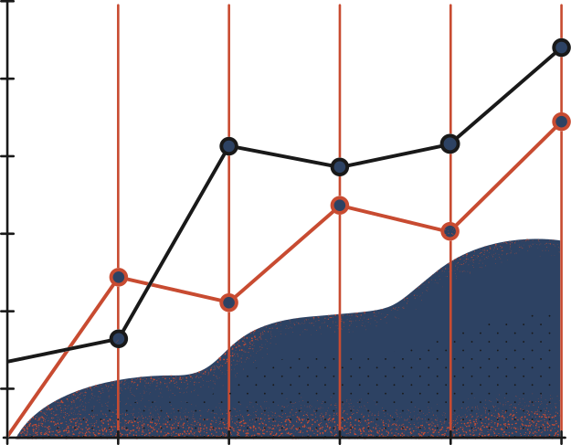

Tuesday, 17/12/24
Computer & Information Systems Engineering , NED University of Engineering and Technology
Machine Vision Pipeline for Steel Surface Defects Detection using FPGA SoC
STUDENT
SUPERVISOR
Aaliyan Mansoor CS-21146 (3.1)
Muhammad Babar Ali CS-21145 (2.9)
Mohib Ud Din CS-21142 (2.7)
Muhammad Maaz Khan CS-21019 (2.6)
Ms. Fakhra Aftab
CO-SUPERVISOR
Dr. Majida Kazmi

Slide 2
Table of Contents
Page
I
Introduction & Background
3
II
Task Division
6
III
Milestones Achieved Summary
7
IV
Literature Review
9
V
Data Preprocessing
11
VI
Model Training & Optimization
13
VII
FPGA Deployment
17
VIII
Conclusion & Future Plan
19

Slide 3
I
Introduction and Background
Introduction
Significance and Motivation
Steel Surface Defects: Critical for industries (automotive, aerospace, manufacturing).
Types of Defects: Cracks, inclusions, scratches, pitted surfaces.
Challenges:
Traditional methods: slow, manual, low precision.
GPUs/CPUs: High energy usage, slower processing.
Solution: FPGA-based Machine Vision Pipeline
High accuracy, energy efficiency
Combines Deep Learning with FPGA Efficiency.
Solves trade-offs:
Speed, Accuracy, Energy Efficiency.
Aligns with Smart Manufacturing goals:
Automation, energy efficiency, and quality assurance.
Sets a benchmark for AI solutions in resource-constrained environments.
3

Slide 4
I
Introduction and Background
Aims and Objectives
Methodology
Aim: Steel surface defect detection using FPGA SoC.
Objectives:
Develop a robust deep learning model for defect detection.
Preprocess and optimize datasets.
Deploy the model on FPGA for high-speed, low-power inference.
Evaluate metrics:
Accuracy, Latency, and Energy Efficiency.
Benchmark against CPU and GPU-based systems.
Ensure scalability for industrial adoption.
Dataset Preparation
Model Selection and Training
FPGA Deployment
Performance Evaluation
Comparative Analysis
4

Slide 5
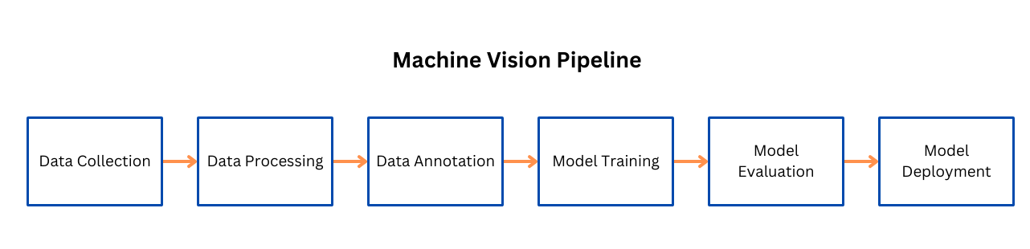
I
Introduction and Background
Machine Vision Pipeline
Visual Flowchart:
Machine Vision Pipeline for Steel Surface Defect Detection.
5

Slide 6

I
Task Division
Task Division
Aaliyan Mansoor: Performed model inspection and quantization, data preprocessing (AgriAutos dataset)
Muhammad Babar Ali: Performed model inspection and quantization, model training and optimization
Mohib Ud Din: Performed data preprocessing (NEUDET+GC10DET), model training and optimization
Muhammad Maaz Khan: Performed data preprocessing (NEUDET), model inspection and quantization
Literature review and report writing was done collectively by all members.
6

Slide 7

I
Milestones Achieved Summary
Dataset Preparation
3.Model Deployment on FPGA
Datasets Used:
NEU-DET, GC10-DET (Public Datasets)
Agriauto Industry-Specific Dataset
Key Tasks:
Data inspection, annotation, augmentation (Roboflow).
FPGA Board: Avnet Ultra96-V2 (Zynq UltraScale+ MPSoC).
Vitis AI Workflow:
Model Inspection, Quantization (INT8).
Initial Deployment of YOLOv5n.
2.Model Selection and Training
Compared YOLOv3 and YOLOv5 for speed, accuracy, and resource utilization.
Selected Model: YOLOv5n (lightweight, fast, accurate).
Optimization: Hyperparameter tuning, iterative training.
7

Slide 8
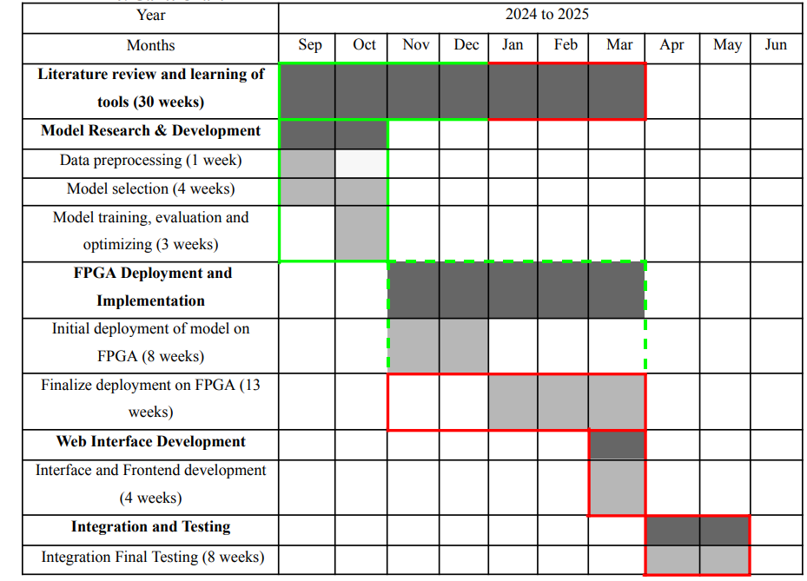
I
Milestones Achieved Summary (Gantt Chart)
Gantt Chart
8

Slide 9

II
Literature Review
Literature Review
Purpose: To review advancements in machine vision for steel surface defect detection and deployment on FPGA SoC.
Resources Used: IEEE, ElsvierScopus & SpringerLink
Key Insights:
YOLO models most widely used for deployment on FPGAs
Publicly available datasets widely used for comparison of models
Performance metrics used to evaluate models
Advantages of FPGAs over CPUs and GPUs
Challanges faced in model deployment on FPGAs
Impact on Project: shaped project objectives, provided a guided methodology and focus toward innovation
9

Slide 10
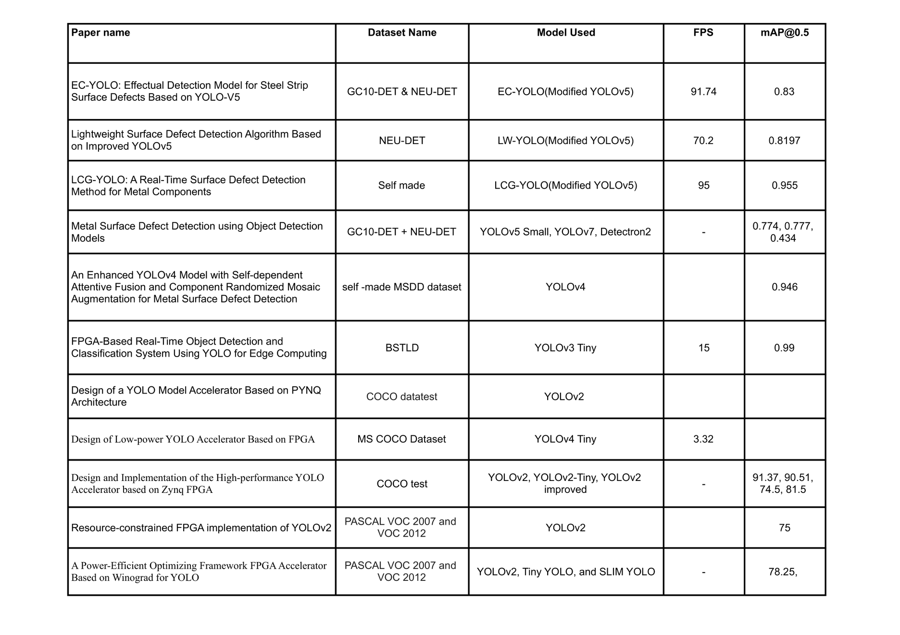
II
Literature Review (Table)
10

Slide 11
II
Data Preprocessing
Key Steps in Data Preprocessing
1.Data Inspection
Filtered clear, noise-free images.
Discarded low-resolution and blurry images.
3.Data Augmentation
Techniques Applied:
90° Rotations: Clockwise, Counterclockwise, Upside-down.
Crop: Up to 10% zoom.
Rotation: Random angles (-10° to +10°).
Cutout: Simulated occlusions.
Outcome: 3 augmented versions per image for dataset diversity.
2.Data Annotation
Annotated using Roboflow with bounding boxes:
Categories: Cracks, Inclusions, Scratches
Exported in YOLOv5-compatible format.
11

Slide 12
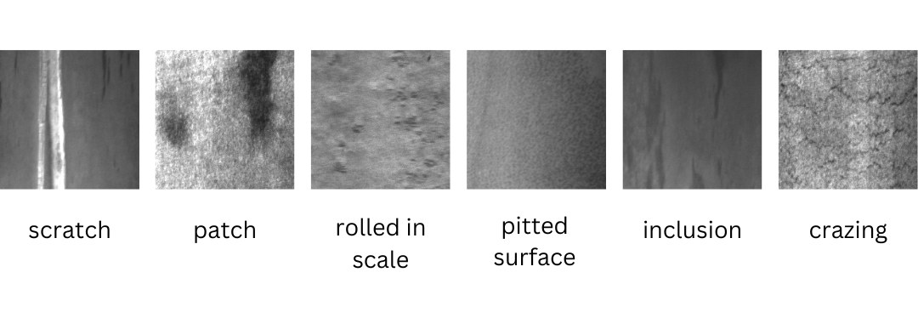
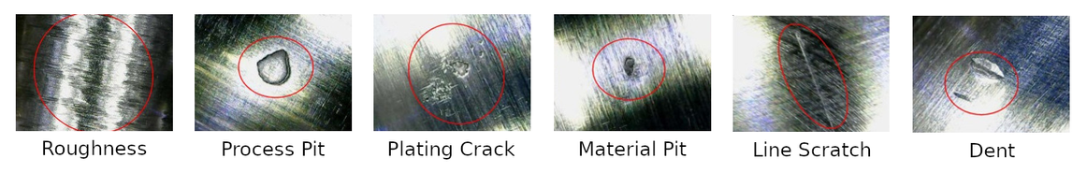
II
Data Preprocessing
Key Steps in Data Preprocessing
NEU-DET dataset defects
4.Dataset Split
Train: 80%
Validation: 10%
Test: 10%
5.Conversion and Organization
Annotation Format: [class_id, x_center, y_center, width, height]
Directory Structure:
images: Train, Val, Test
labels: Corresponding .txt annotations
Defects on steel rods from Agriauto dataset
12

Slide 13
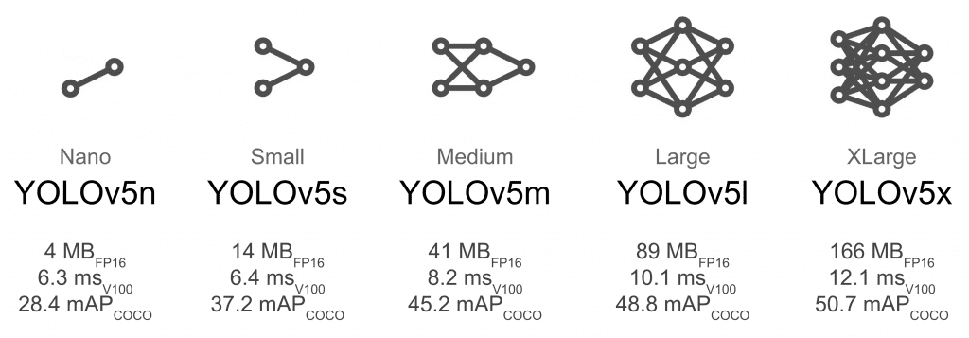
III
Model Training & Optimization
Model Training & Optimization
Model Options Available:
comparing YOLOv3, YOLOv5, YOLOv7 and YOLOv11
YOLOv7 and YOLOv11 excluded due to hardware constraints
Comparing YOLOv3 and YOLOv5:
YOLOv3 is faster than YOLOv5
Although, YOLOv5 offers better accuracy
However, YOLOv5 incorporates efficient network architecture thus requiring lesser memory bandwidth
Comparing Variants of YOLOv5:
YOLOv5x, YOLOv5l, and YOLOv5m require a lot of memory bandwidth
YOLOv5n is the most widely used, FPGA friendly model offering a great balance between accuracy and performance
13

Slide 14
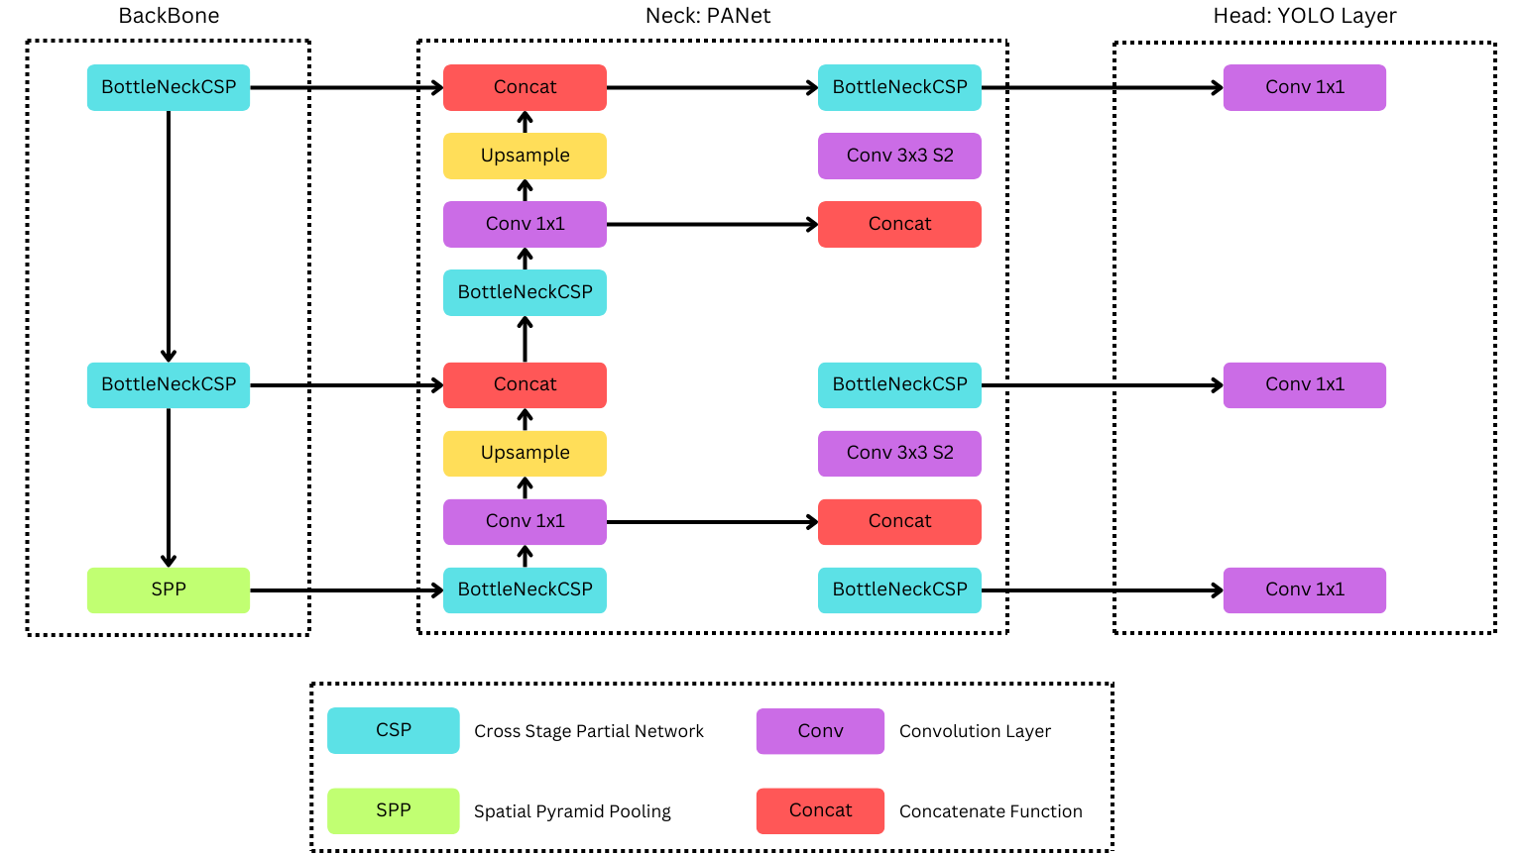
IV
Model Training & Optimization (Architecture)
Backbone: extract features from input image
Neck: gathers information from various scales to find out defects of diversified sizes.
Head: outputs bounding boxes and class probabilities for all
Activation Functions: ReLU, LeakyReLU, Mish, SiLU
14

Slide 15
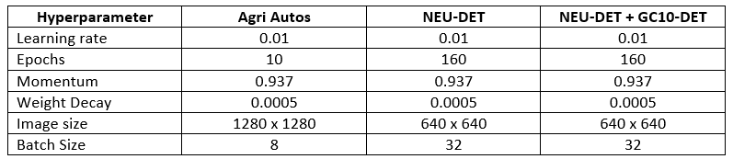
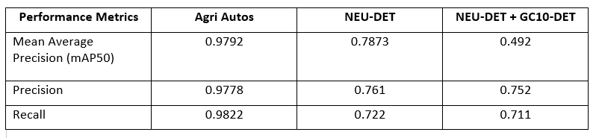
IV
Model Training & Optimization (Results)
Training Parameters for YOLOv5n
Performance Metrics of YOLOv5n
15

Slide 16
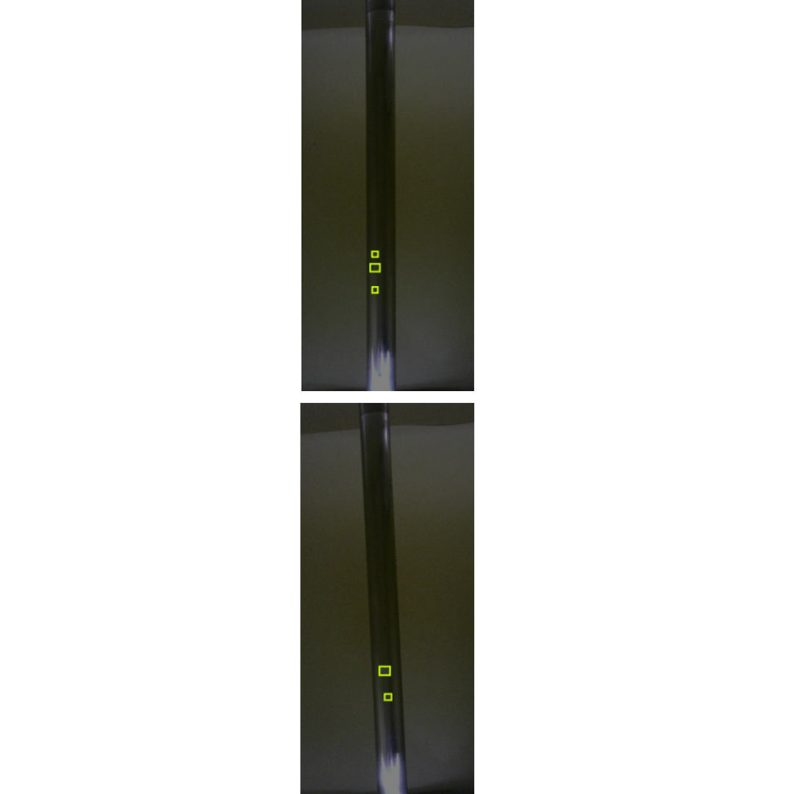
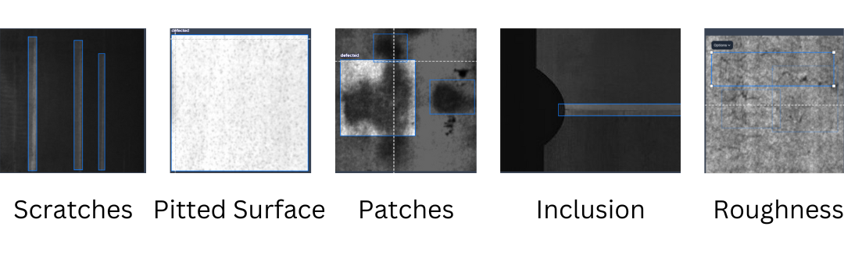
IV
Model Training & Optimization (Results)
Inference Results of YOLOv5n on NEU-DET+GC10-DET Dataset
Inference Results of YOLOv5n on Agriautos Dataset
16

Slide 17
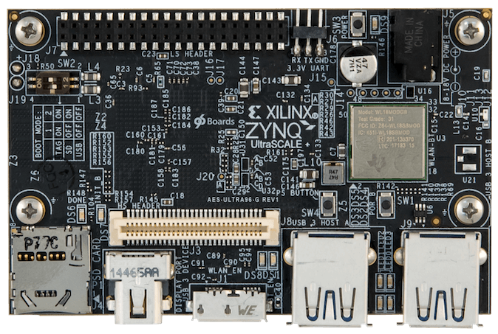
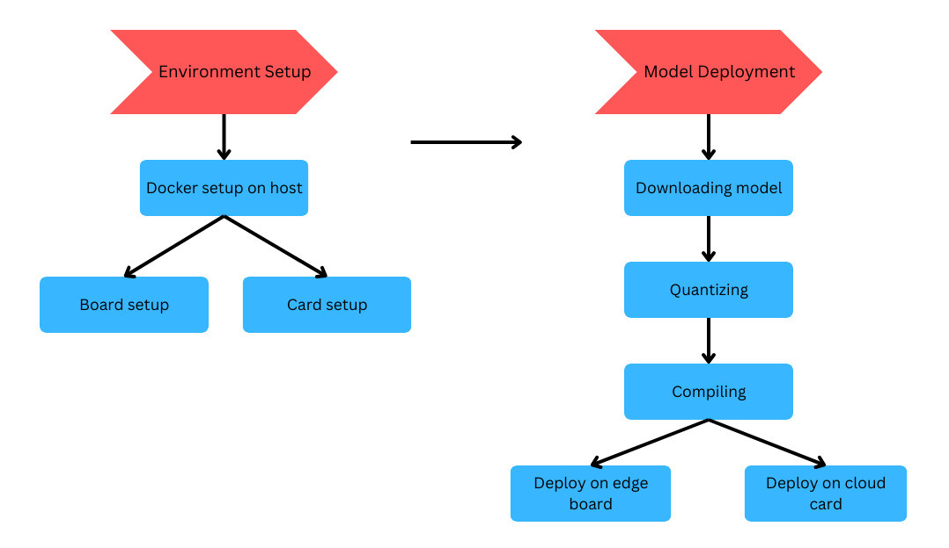
IV
FPGA Deployment
FPGA Deployment
FPGA Board Used:
Avnet Ultra96-v2, an ARM-based zynq Ultrascale+ MPSoC
CLBs, LUTs
Deployment Framework:
Vitis-AI, developed by Xilinx to accelerate AI inference
Deployment workflow:
Environment Setup
Quantization of float model
Compiling quantized model
Deployment on FPGA board
17

Slide 18
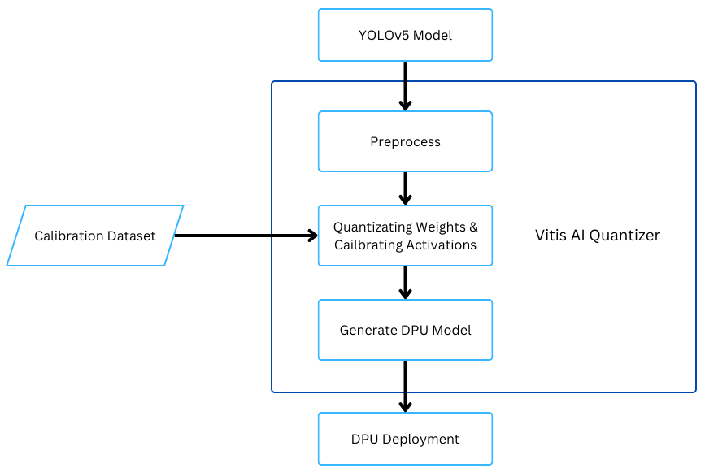
IV
FPGA Deployment (Inspection & Quantization)
Inspection & Quantization
Inspection: check if model is quantizable in it’s current form
Preparation:
Yolov5 default activation function changed
Permute and View functions in last layer of detection head removed
Quantization:
Conversion of weights and activations from Float32 to Int8
To reduce computational complexity
PTQ (Post Training Quantization) and QAT (Quantization Aware Training)
18

Slide 19

V
Conclusion & Future Plans
Complete Deployment on FPGA
Using Vitis-AI and deployment software, complete implementation of the model on the FPGA hardware.
Extensive Testing & Optimization of Deployed Model
Evaluate the deployed system for accuracy, FPS ,and resource utilization. Optimize and improve the system to achieve the best possible results.
Interface Development
Design a user-friendly interface for system operation and defect analysis.
19

Slide 20

The End
Thank you!

